Slide 1
Désirée’s Baby (1893)
Kate Chopin (1850-1904)

Slide 2
Context of composition & setting
Where and when was this story written? (historical context)
What is the setting of this story? (the word 'setting' is used to identify and establish the time, place and mood of the events of the story. It basically helps in establishing where and when and under what circumstances the story is taking place.)
My notes:

Slide 3
Before reading
READING SKILLS: PREVIEWING
When you preview a selection, you look it over to see what lies ahead. You might scan the title and skim paragraph or two to get an idea of the writer’s subject and style. Preview Kate Chopin’s story. What predictions can you make?
My predictions:

Slide 4
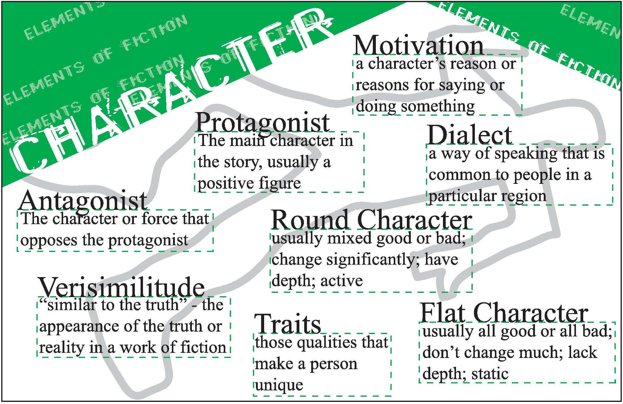
While reading
READING SKILLS: characterization -- Read the short story
Who are the main characters? What do we learn about them? What are the main themes?

Slide 5
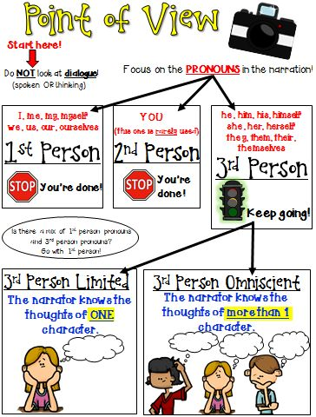
Point of View
Analyze the story’s point of view.
Narrator?
Narration?

Slide 6
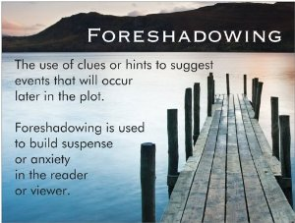
Foreshadowing
Find instances of foreshadowing.
Foreshadowing is a literary device in which a writer gives an advance hint of what is to come later in the story. Foreshadowing often appears at the beginning of a story or a chapter and helps the reader develop expectations about the coming events in a story.

Slide 7
The ending
Is the outcome of the story predictable, unpredictable, surprising? Why?
What do you think about it?
Try and classify the genre of this story.

Slide 8
Creative Writing Project
Tic Tac Toe activity
Character analysis worksheet (part 1)
Character analysis handout (part 2)
Share your work on this Google Doc.

Slide 9
Flipped learning
Study this video (story anlysis) and share your findings on this collaborative Google Doc.
Do you agree with the student?
We’ll discuss your findings in class.

Slide 10
Homework
Review literary terms on Quizlet.
Find The Top 60 Most Common Academic Words list here.
Study them.

Slide 11
Bibliography
Grellet Françoise, 10 short stories, From Guided Reading to Autonomy, Hachette Education.
Kate Chopin
Désirée’s Baby
Enotes
Cummings Study Guide
Bookrags
GradeSaver

